Slide 1
Rockbuster Stealth llc
A Movie Rental Company – Data Analysis
By: Dallas Skoda
April 17th, 2023

Slide 2
Part I: Company Overview
Rockbuster Stealth LLC – Current Situation
Questions and Objectives

Slide 3
Rockbuster Stealth llc A movie rental store that used to have stores around the world
CURRENT SITUATION
Facing stiff competition from streaming services such as Netflix and Amazon Prime, the Rockbuster Stealth management team is planning to use its existing movie licenses to launch an online video rental service in order to stay competitive
COMPANY OVERVIEW
CUSTOMERS: 599
COUNTRIES: 108
FILMS: 1000
*GENRES: 17 (20)
REVENUE: $61,312.04
*NOTE: There are 20 different genres, but “War”, “Crime” and “Romance” have no sales

Slide 4
Rockbuster stealth llc
Questions
Objectives
Which movies contributed the most/least to revenue gain?
What was the average rental duration for all videos?
Which countries are Rockbuster customers based in?
Where are customers with a high lifetime value based?
Do sales figures vary between geographic regions?
Help with the launch strategy for the new online video service
Work with Rockbuster Stealth’s Business Intelligence (BI) department who helps other departments with data-related queries

Slide 5
Part II: rockbuster analysis
Revenue by Genre and Movie Titles
Descriptive Statistics and Average Rental Durations by Genre
Countries & Clients with Greatest Revenue

Slide 6
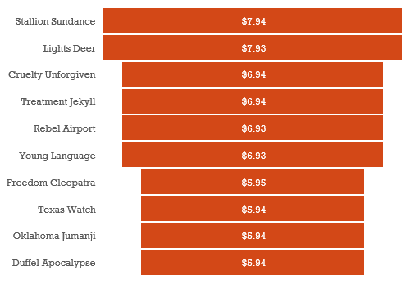
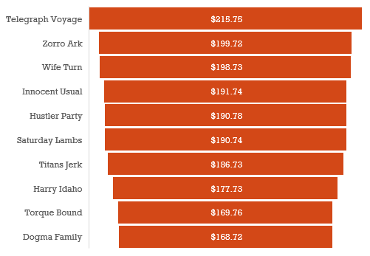
Question 1: Most/Least revenue by movie title
Top 10 Movies
Bottom 10 Movies
No heavy weighting in any particular genre for either category

Slide 7
Descriptive statistics
Question 2:
Average Rental Duration
For all Videos
Rental Rates
Minimum | $0.99
Maximum | $4.99
Average | $2.98
Rental Duration (Days)
Minimum | 3
Maximum | 7
Average | 5
MOVIE OVERIVEW
Rental Duration
Rental Rates
Replacement Costs
Movie Lengths
Movie Length (Minutes)
Minimum | 46
Maximum | 185
Average | 115
What do we want to know?
2a. Is there a correlation between rental
duration and the other factors?
2b. Does Rental Duration have any
bearing on which movies produce
more revenue?
Replacement Costs
Minimum | $9.99
Maximum | $29.99
Average | $19.98

Slide 8
2a. Is there a correlation?
Thriller genre has the longest average rental duration of 6 Days
Rental duration varies between 4 and 6 Days
Rental Duration has low Correlation to other factors
Correlation | Avg. Length | Avg. Replacement Cost | Avg. Rental Rate
Avg. Duration | 0.45: Low | 0.47: Low | 0.06: Very Low

Slide 9
Rental Duration to Rental Cost Very low correlation

Slide 10
Rental Duration to Movie Length low correlation

Slide 11
Rental Duration to Replacement Cost low correlation

Slide 12
2b.Movie Revenue
Sports has the highest revenue despite having the
shortest average rental duration
TOP 5 GENRES
Sports: $4,892
Sci-Fi: $4,336
Animation: $4,245
Drama: $4,118
Comedy: $4,002
RANKING FOR DURATION
Sports: 17th
Sci-Fi: 13th
Animation: 12th
Drama: 6th
Comedy: 11th
Thriller has the lowest revenue despite having the
longest average rental duration

Slide 13
Question 2 – Summary
Rockbuster wants to know the total average duration of all movies
Average Duration is 5 days
Average Duration by Genre ranged between 4 – 6 Days
2a. Is there a correlation between Rental Duration and Rental Rate, Replacement Cost and/or Movie Length?
Low to Very Low Correlation
2b. Does Rental Duration have any bearing on which movies produce more revenue?
Thriller has the highest average rental duration, but the lowest revenue produced.
Sports has the lowest average rental duration, but the highest revenue produced.
This suggests that average rental duration has no bearing on revenue produced

Slide 14
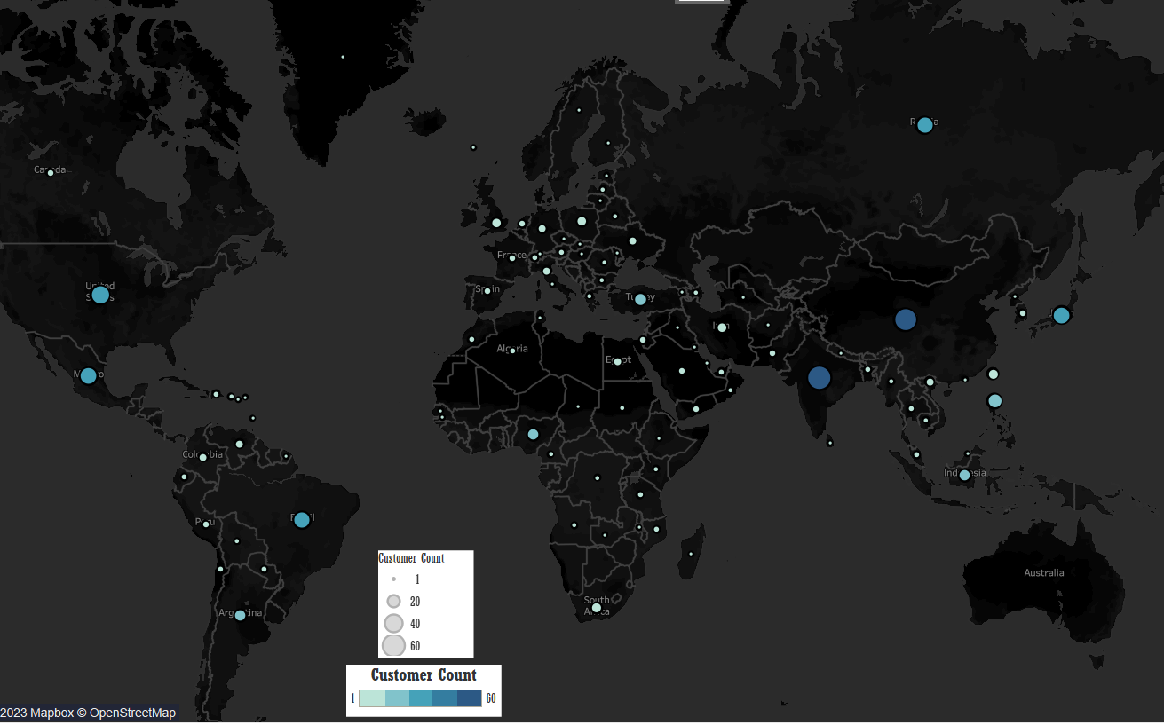
Question 3: Rockbuster client locations
Country Name | Customers
India | 60
China | 53
United States | 36
Japan | 31
Mexico | 30
Brazil | 28
Russian Federation | 28
Philippines | 20
Turkey | 15
Indonesia | 14
These countries make up 52.59% of Rockbuster’s customer base; Leaders are India, China & U.S.

Slide 15
Question 4: Rockbuster high lifetime value customers
Customer ID | First Name | Last Name | City | Country | Total Payment
148 | Eleanor | Hunt | Saint-Denis | Runion | $211.55
526 | Karl | Seal | Cape Coral | United States | $208.58
178 | Marion | Snyder | Santa Brbara dOeste | Brazil | $194.61
137 | Rhonda | Kennedy | Apeldoorn | Netherlands | $191.62
144 | Clara | Shaw | Molodetno | Belarus | $189.60
459 | Tommy | Collazo | Qomsheh | Iran | $183.63
181 | Ana | Bradley | Memphis | United States | $167.67
410 | Curtis | Irby | Richmond Hill | Canada | $167.62
236 | Marcia | Dean | Tanza | Philippines | $166.61
403 | Mike | Way | Valparai | India | $162.67
Eleanor Hunt from Saint-Denis, Runion has the highest lifetime contribution

Slide 16
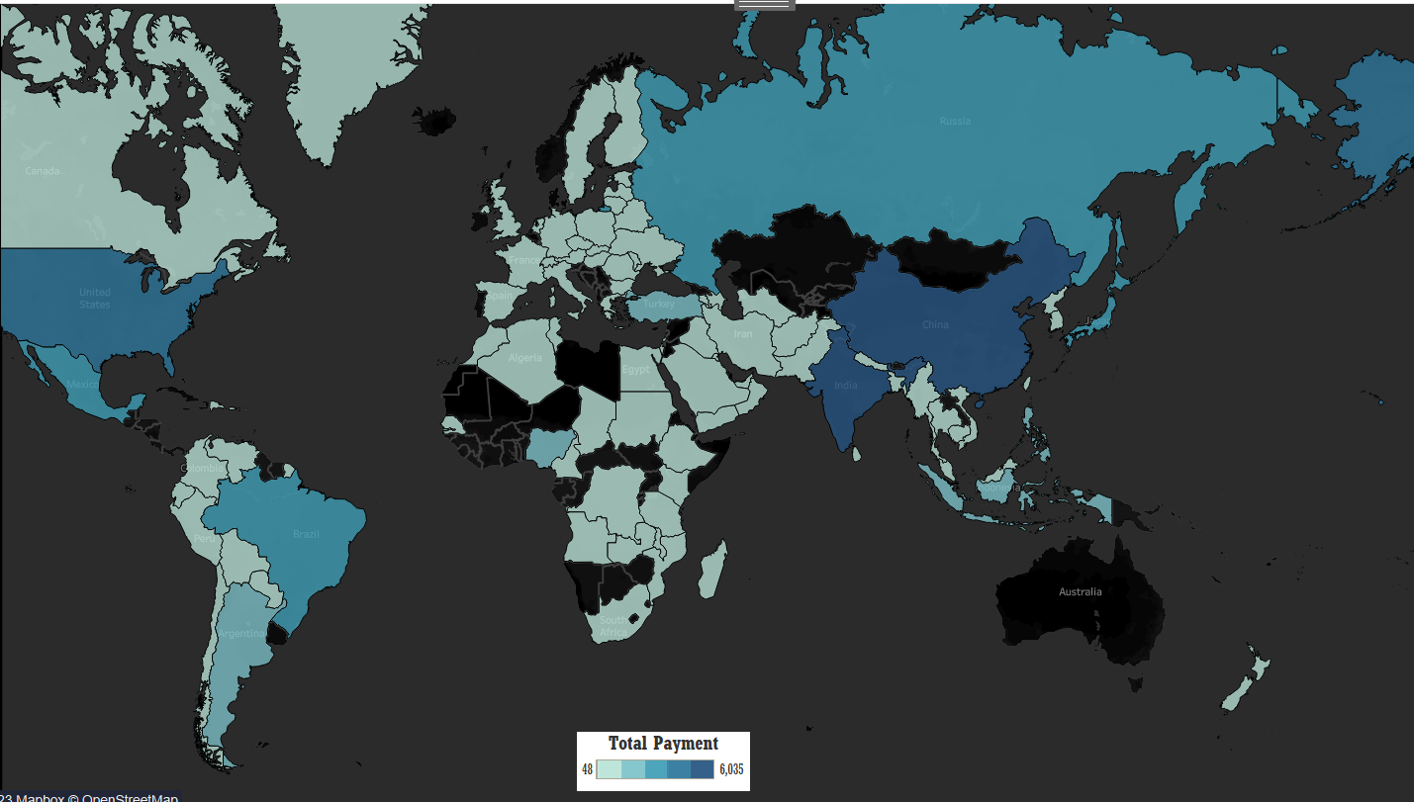
Question 5: Rockbuster sales concentration
Country Name | Country Sales
India | $ 6,034.78
China | $ 5,251.03
United States | $ 3,685.31
Japan | $ 3,122.51
Mexico | $ 2,984.82
Brazil | $ 2,919.19
Russian Federation | $ 2,765.62
Philippines | $ 2,219.70
Turkey | $ 1,498.49
Indonesia | $ 1,352.69
These countries make up 51.92% of Rockbuster’s total revenue; Leaders are India, China & U.S.

Slide 17
India Movie Preferences
Top 10 Movies
Top 100 Count
TITLE | GENRE | REVENUE
Wife Turn | Documentary | $ 67.91
Innocent Usual | Foreign | $ 52.92
Sabrina Midnight | Children | $ 41.93
Secret Groundhog | Documentary | $ 38.93
Harry Idaho | Drama | $ 36.95
Whisperer Giant | Sci-Fi | $ 30.96
Jerk Paycheck | Classics | $ 30.95
Hustler Party | Comedy | $ 27.97
Torque Bound | Drama | $ 27.96
Enemy Odds | Music | $ 27.96
Sports | 6
Sci-Fi | 7
Animation | 4
Drama | 9
Comedy | 6
New | 8
Action | 7
Foreign | 8
Games | 6
Family | 4
Documentary | 7
Horror | 6
Classics | 7
Children | 11
Travel | 1
Music | 3
Thriller | 0
Out of the Top 100 Movies
By revenues generated:
Documentary was the most
common in the Top 10
Children was the most common
in the top 100; Drama was second
Thriller never came up once

Slide 18
China Movie Preferences
Top 10 Movies
Top 100 Count
TITLE | GENRE | REVENUE
Zorro Ark | Comedy | $ 35.95
Secrets Paradise | Family | $ 34.96
Balloon Homeward | Music | $ 32.93
Range Moonwalker | Family | $ 27.96
Maltese Hope | Games | $ 27.95
Eagles Panky | New | $ 26.97
Doors President | Animation | $ 25.97
Memento Zoolander | Comedy | $ 25.96
Enemy Odds | Music | $ 25.96
Forrester Comancheros | Animation | $ 25.95
Sports | 5
Sci-Fi | 5
Animation | 10
Drama | 7
Comedy | 6
New | 10
Action | 5
Foreign | 3
Games | 11
Family | 8
Documentary | 5
Horror | 6
Classics | 5
Children | 5
Travel | 4
Music | 5
Thriller | 0
Out of the Top 100 Movies
By revenues generated:
Comedy, Family, Music and
Animation all appeared
twice in the Top 10
Games was the most common
in the Top 100; New and
Animation were second
Thriller never came up once

Slide 19
U.S. Movie Preferences
Top 10 Movies
Top 100 Count
TITLE | GENRE | REVENUE
Show Lord | Documentary | $ 32.95
Scorpion Apollo | Drama | $ 26.96
Hustler Party | Comedy | $ 24.97
Moonwalker Fool | Games | $ 23.97
Titans Jerk | Sci-Fi | $ 22.97
Cupboard Sinners | Documentary | $ 21.96
Range Moonwalker | Family | $ 20.98
English Bulworth | Sci-Fi | $ 19.96
Boogie Amelie | Music | $ 19.96
Fool Mockingbird | Action | $ 18.98
Sports | 9
Sci-Fi | 8
Animation | 3
Drama | 10
Comedy | 7
New | 2
Action | 5
Foreign | 7
Games | 7
Family | 8
Documentary | 8
Horror | 11
Classics | 6
Children | 3
Travel | 2
Music | 4
Thriller | 0
Out of the Top 100 Movies
By revenues generated:
Documentary and Sci-Fi were
the most common in the Top 10
Horror was the most common in
the Top 100; Drama was second
Thriller never appeared once

Slide 20


Rockbuster customer count vs total payment
Top 25 Countries by Highest Payment
Country | Customer Count | Total Payment | Average Payment
India | 60 | $ 6,034.78 | $ 100.58
China | 53 | $ 5,251.03 | $ 99.08
United States | 36 | $ 3,685.31 | $ 102.37
Japan | 31 | $ 3,122.51 | $ 100.73
Mexico | 30 | $ 2,984.82 | $ 99.49
Brazil | 28 | $ 2,919.19 | $ 104.26
Russian Federation | 28 | $ 2,765.62 | $ 98.77
Philippines | 20 | $ 2,219.70 | $ 110.99
Turkey | 15 | $ 1,498.49 | $ 99.90
Indonesia | 14 | $ 1,352.69 | $ 96.62
Nigeria | 13 | $ 1,314.92 | $ 101.15
Argentina | 13 | $ 1,298.80 | $ 99.91
Taiwan | 10 | $ 1,155.10 | $ 115.51
South Africa | 11 | $ 1,069.46 | $ 97.22
Iran | 8 | $ 877.96 | $ 109.75
United Kingdom | 9 | $ 850.96 | $ 94.55
Poland | 8 | $ 786.16 | $ 98.27
Italy | 7 | $ 753.26 | $ 107.61
Germany | 7 | $ 741.24 | $ 105.89
Vietnam | 6 | $ 676.45 | $ 112.74
Ukraine | 6 | $ 675.53 | $ 112.59
Colombia | 6 | $ 661.54 | $ 110.26
Egypt | 6 | $ 659.48 | $ 109.91
Venezuela | 7 | $ 632.43 | $ 90.35
Canada | 5 | $ 559.70 | $ 111.94
The countries with the highest Average payment per customer:
Taiwan
Vietnam
Ukraine
Canada
Countries that produce higher average payment per customers should be targeted

Slide 21
Taiwan and Canada
Taiwan Top 10 | name | total_revenue
Secrets Paradise | Family | $ 18.98
Ishtar Rocketeer | Animation | $ 15.98
Titanic Boondock | Animation | $ 15.97
Forrester Comancheros | Animation | $ 14.97
Interview Liaisons | New | $ 13.98
Zorro Ark | Comedy | $ 12.98
Galaxy Sweethearts | Classics | $ 12.98
Poseidon Forever | Sports | $ 12.98
Closer Bang | Comedy | $ 12.98
Secret Groundhog | Documentary | $ 11.98
Canada Top 10 | name | total_revenue
Hustler Party | Comedy | $ 18.98
Telegraph Voyage | Music | $ 16.98
Hanky October | Sci-Fi | $ 15.97
Videotape Arsenic | Games | $ 14.97
Snatch Slipper | Comedy | $ 12.98
Thief Pelican | Animation | $ 12.98
Show Lord | Documentary | $ 10.99
Invasion Cyclone | Children | $ 10.98
Day Unfaithful | New | $ 9.99
Moonshine Cabin | Games | $ 9.99
Taiwan: Animation is the most Common
Canada: Comedy is the most Common

Slide 22
Vietnam and Ukraine
Vietnam Top 10 | name | total_revenue
Harry Idaho | Drama | $ 16.98
Dawn Pond | Games | $ 13.98
Valley Packer | Comedy | $ 12.98
Virgin Daisy | Drama | $ 12.98
Scalawag Duck | Music | $ 11.98
Vanilla Day | Games | $ 11.98
Champion Flatliners | Animation | $ 11.98
King Evolution | Family | $ 10.99
Operation Operation | Comedy | $ 10.97
Flintstones Happiness | Comedy | $ 9.99
Ukraine Top 10 | name | total_revenue
Telegraph Voyage | Music | $ 20.98
Lawless Vision | Animation | $ 13.98
Stagecoach Armageddon | Action | $ 12.98
Reds Pocus | Music | $ 11.98
American Circus | Action | $ 10.99
Waterfront Deliverance | Action | $ 9.99
Panky Submarine | Games | $ 9.99
Ace Goldfinger | Horror | $ 9.99
Galaxy Sweethearts | Classics | $ 9.99
Disturbing Scarface | Sci-Fi | $ 9.98
Vietnam: Comedy is the most Common
Ukraine: Action is the most Common

Slide 23
Part III: Conclusion
Summary of Data
Recommendations

Slide 24
summary
Genre with longest Average Rental Duration*: | Thriller
Top 5 Genres for Revenue: | Sports, Sci-Fi, Animation, Drama, Comedy
Top Movie for Revenue: | Telegraph Voyage (Music): $215.75
Bottom Movie for Revenue (Tied): | Texas Watch (Horror): $5.94 Oklahoma Jumanji (New): $5.94 Duffel Apocalypse (Documentary): $5.94
Top Countries for Sales Revenue: | India, China, United States: 51.92%
Top Countries for Customers: | India, China, United States: 52.92%
Top Client with the Highest Lifetime Value: | Eleanor Hunt: $211.55
Highest Average Payment per Client: | Taiwan: $115.51 Vietnam: $112.74 Ukraine: $112.59
*Average Duration was shown to have little correlation compared to Length, Replacement Cost
and Rental Rate suggesting that these factors do not affect one another

Slide 25
Recommendations
Rockbuster generates the most revenue: India, China and the United States INDIA: Within the Top 100 movies, Documentary, Drama and Children genres are the most common CHINA: Within the Top 100 movies, Games, Animation and New genres are the most common US: Within the Top 100 Movies, Documentary, Sci-Fi, Horror and Drama genres are the most common These are the genres that should be targeted within these regions and have the libraries expanded Thriller should be abandoned as it has generated no revenue in any of the top 100 movies.
Taiwan, Vietnam, Ukraine and Canada have the highest purchasing power; Rockbuster should increase sales based on those countries preferences: Taiwan: Animation Vietnam: Comedy Ukraine: Action Canada: Comedy

Slide 26
Recommendations – Continued
3. Rockbuster should focus on expanding their movie libraries to include more of the top genres: Sports, Sci-Fi, Animation, Drama, Comedy. Particularly the ones that appear in the countries with the most revenue (previous slide)
4. Rockbuster should continue to reward High Lifetime customers. Rewards programs could increase loyalty and increase market share: EX) Introduce a points program to offer reduced prices for long time customers EX) Provide early access to movies and offer private screenings for new movies before they become available to the public EX) Offer family rates based on households so that people under the same roof can receive discounts
5. Rockbuster should attempt to expand their focus to countries that they do not occupy: Australia & Africa; Australia has absolutely no customer base and Africa’s customer base has large portions that have been untapped

Slide 27
Thank you!
Presented by: Dallas Skoda
Questions: dallasskoda@gmail.com
Tableau Visualization: Rockbuster Customer Count Worldwide | Tableau Public

